Slide 1
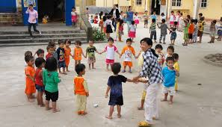
Enabling Young Children’s Participation
Meenakshi Dahal, PhD

Slide 2
Who is the adult we are nurturing now?
Competent/ Confident
Kind
Compassionate
Ethical
Self-Reliant
Gritty and resilient
Fun/Humorous
Grateful
Faith in the Greater
Notes:
I hope I did this right because I want to enjoy my children as adults. The children I taught in the beginning are now adults. I wonder about them a lot. You may have a different list.

Slide 3
The Whole Child
intellectually active;
physically, verbally, socially and
academically competent;
empathic, good, caring and just;
creative and curious;
disciplined, self-directed and goal-oriented;
free;
critical thinker;
self-confident; and
appreciated and careful.
(Whole Child Commission (2007/8)
zf/Ll/s ¿kdf :j:Yo, af}l4s?kdf rnfv, ;+j]ufTds ¿kdf l:y/, ;fdflhs ¿kdf ;Ifd / l;sfOsf] nflu tof/ cj:yf

Slide 4
What do we know about early learning and development
Brain Development is rapid and at peak pliability in the first five years of life.
Young Children learn best by engaging all senses- active learning
Motor development happens from the core to the extremities and leads cognition.
Language Development and Emergent Literacy are closely connected.
The experiences of those early eight years shape lifetime aptitude.
There is reason for urgency, but it has been misplaced.
Notes:
Neural Pathways are being created.
Neuroplasticity is at it’s peak
Optimal Processing occurs through active learning.- Neural pathways are created and cemented through experiences and interactions with the environment.
There is a good reason that young children don’t stay still. They are simply not supposed to- They are not supposed to sit and write at three years old. Their bodies are still learning reciprocal movements.
Languages will be learned without an accent.
Instruction and Curriculae cannot simply begin Earlier
Language and Emergent Literacy are the understanding of symbolism a major task of early childhood
Children in the first and second year of life are already becoming literate
The brain changes in the school age child. BUT the canvas has been developed at that point.

Slide 5
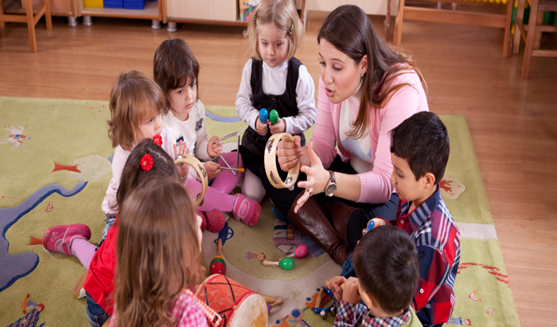
Defining Participation
‘the process by which children and young people have active involvement and real influence in decision-making on matters affecting their lives, both directly and indirectly’.
This definition is consistent with Article 12 of the UN Convention on the Rights of the Child (UNCRC).
Article 12 of the UNCRC states:
States Parties shall assure to the child who is capable of forming his or her own views the right to express those views freely in all matters affecting the child, the views of the child being given due weight in accordance with the age and maturity of the child.

Slide 6
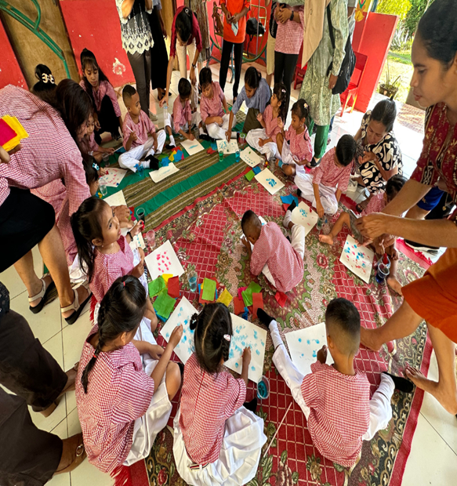
Environment
‘There can be no keener revelation of a society’s soul than the way in which it treats it’s children’ (Mandela, 1995).
Children need to be Heard, Seen and Valued
The early years environment can provide a supportive and safe space in which children can be listened to and a place to express themselves.
By involving children in the decision-making process from an early age, children gain an understanding of why particular options are followed or why certain decisions are taken.
Child participation should focus on the everyday lives of children and the places and spaces they are entitled to have their voice heard (Lundy 2007).
Children require a safe space to enable them to express their views, an audience to listen to and that their views have an influence and genuine impact on the decision-making process.

Slide 7
Nurturing Care Framework
48-60 Months
24-48 Months
Good Health
Nutrition
60-96 Months
0-24 Months
Conception
Holistic Development
Early Learning and Stimulation
Responsive Care
Safety and Security
Enabling Environment

Slide 8
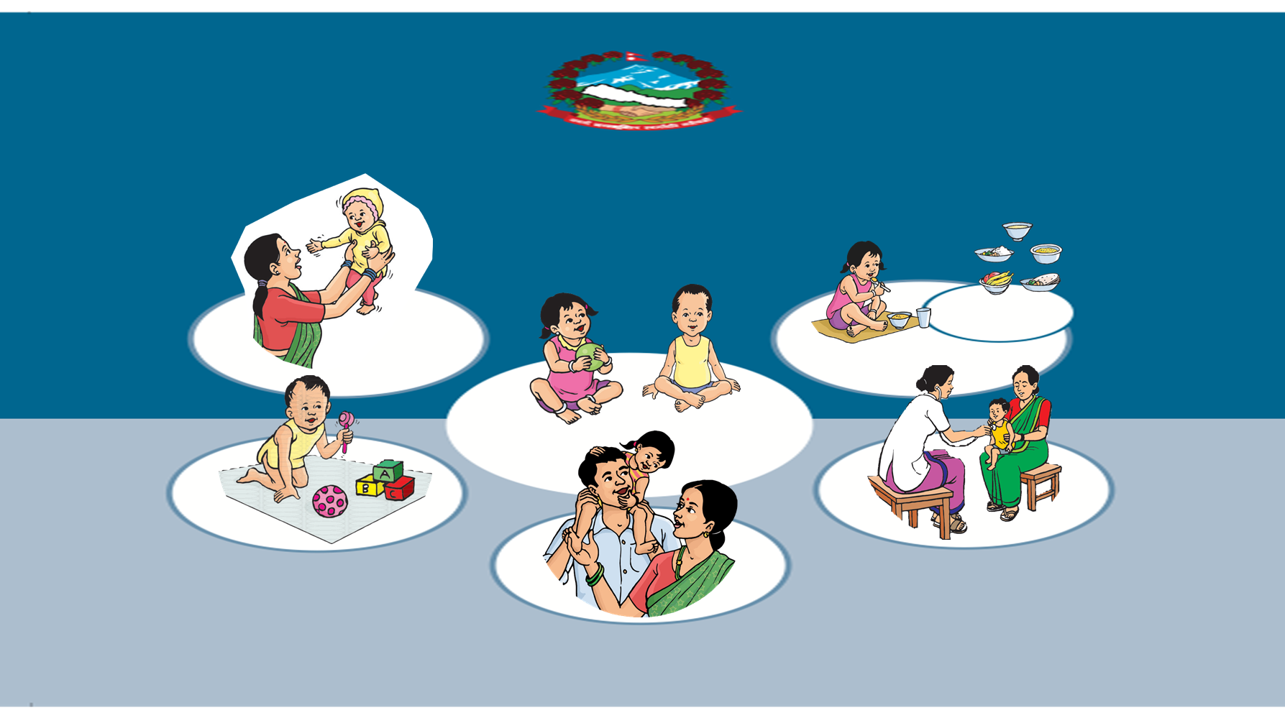
k|f/lDes afnljsf; /fli6«o /0fgLlt @)&&–@)**
!= ax'kIfLo ;+nUgtf
k|f/lDes afnljsf; Ps ax'kIfLo sfo{j|md xf] .
tLg} txsf ;/sf/, ;fdflhs ;ª\3;+:yf, lghL If]q, ;d'bfo /
kl/jf/sf] ;+nUgtf dxTjk""0f{ x'G5 .
@= clwsf/df cfwfl/t
o;n] afnclwsf/sf] ;"lglZrttf u5{ .
afnaflnsfsf]] ;jf]{Qd lxt / l;4fGtnfO{ ;jf]{k/L /fV5 .
#= hLjgrj|mdf cfwfl/t
Affnaflnsf cfˆg} ultdf x'ls{/x]sf x'G5g\, tyflk ;a} afnaflnsfn] ljsf;sf ;dfg k|lj|mof / r/0f kf/ ul//x]sf x'G5g\ .
afnaflnsfsf] ;jf{ª\uL0f ljsf;sf] nflu pgLx¿sf] pd]/ cg';f/sf] ;]jfsf] ;'lglZrttf u5{ .

Slide 9
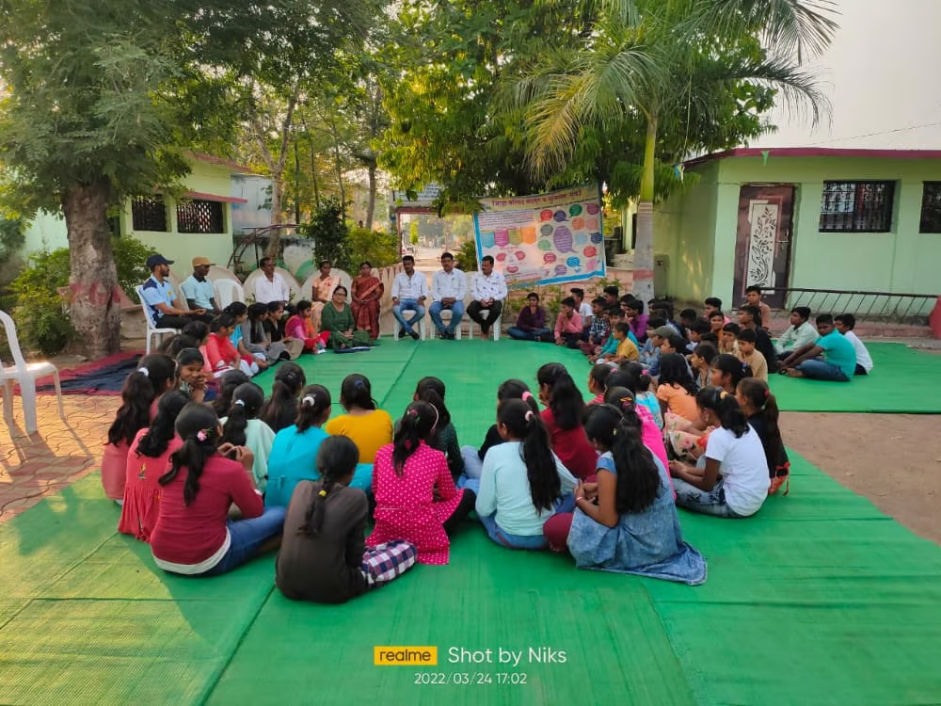
For Meaningful Participation
Children and young people need to have a voice in decisions made in their local communities.
Children and young people need to have a voice in decision-making in early education, schools and the wider formal and non-formal education systems.
Children and young people need to have a voice in decisions that affect their health and well-being, including on the health and social services delivered to them.
Children and young people need to have a voice in the Courts and legal system.

Slide 10
Children’s Participation in Decision- Making
Includes improved services, policies, research, active citizenship and, most importantly, improvements for children themselves and for society generally.
Inclusion can promote children’s protection, improve their confidence, communication skills and ability to negotiate, network and make judgements.
Support active citizenship and social inclusion at an early stage and there is general agreement that this is crucial to building and sustaining a healthy society.
In education, effective and meaningful participation of children and young people has been shown to be beneficial to children and young people, and to schools.
Reduce anti-social behavior and substance abuse, as well as superior academic performance.

Slide 11
Checklist for Participation (Lundy’s Voice Model)

Slide 12
Creating a Supportive Environment
It is about
Children that they are valued, respected, and loved and important people in our lives by providing them with a caring environment.
Ensure that all children, regardless of their abilities receive special care, attention and support for their learning
View children as active learners with agency
Offer children moral, spiritual, social, and emotional support. Special care should be given to children directly affected by violence
Provide children with a safe, secure and supportive environment to protect them from harm and that will help them thrive and become contributing members of their community
Provide an environment that is free from physical and mental abuse, individual or community-level violence, and exploitation
Provide children who have experienced a threat to their existence by creating an environment that is inclusive, respectful, and psychologically safe to support their trauma recovery and restore their stability
Show children that they are valued, respected, and loved and important people in our lives by providing them with a caring environment
Advocate for community spaces (e.g., schools, parks, markets) that prioritize the interests and well-being of children

Slide 13
Transformative Goals

Slide 14
Way Forward
Promoting effective leadership to champion and promote participation of early age children and young people.
Development of education and training for professionals working with and on behalf of early age children and young people.
Mainstreaming the participation of early age children and young people in the development of policy, legislation and research.

Slide 15
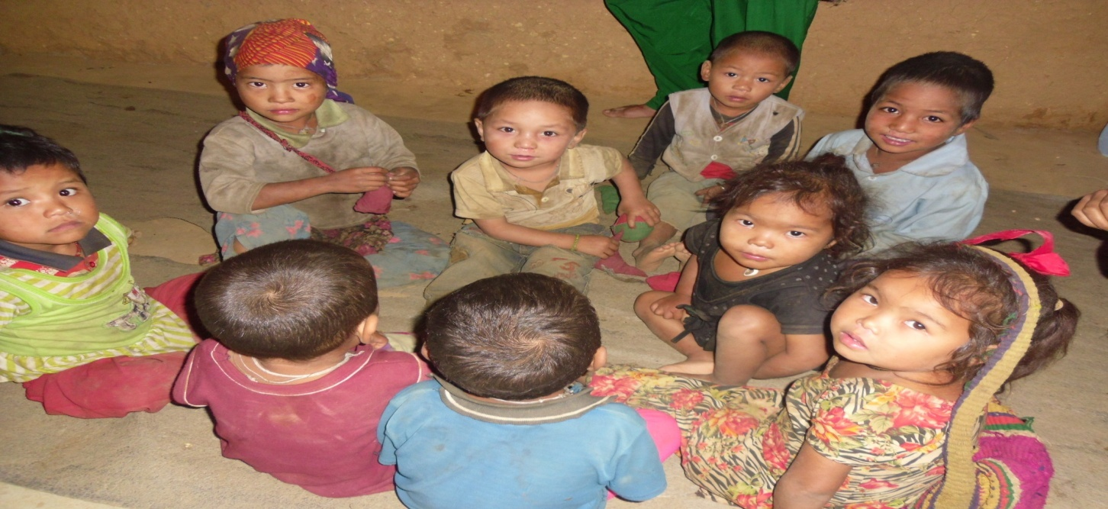
wGojfb

